Slide 1

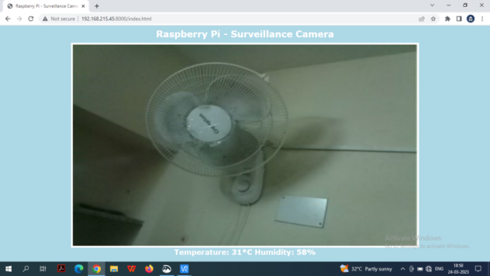
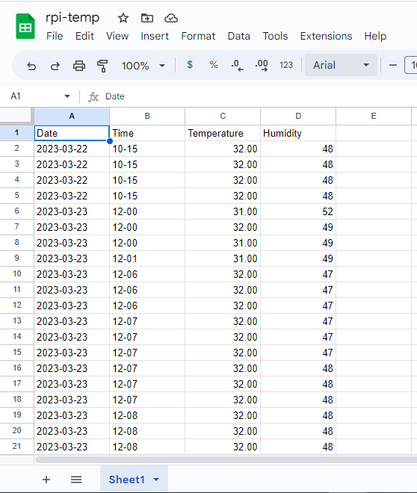
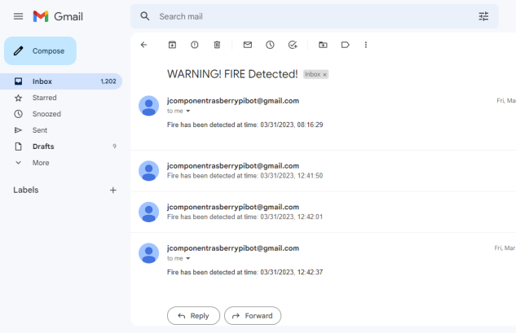
Robotic Car for Fire detection
Saptajit Banerjee 20BCE1513
Prof. Graceline Jasmine S
Vellore Institute of Technology, Chennai
INTRODUCTION
The use of technology in disaster management has become increasingly important in recent years. Among various types of disasters, fire outbreaks pose a significant threat to life and property. Traditional methods of fire detection are often limited in their effectiveness, particularly in large or complex environments. In order to address these challenges, we propose the development of a robotic car for fire detection.
The proposed robotic car is based on Raspberry Pi, a versatile and affordable single-board computer that can be used for a wide range of applications. Equipped with a pi camera and a DHT11 sensor, the robotic car is designed to autonomously navigate through an environment, detect any fire outbreaks, and transmit the location and status of the fire to a remote server.
The pi camera provides real-time visual data of the environment, which can be used to detect the presence of flames or smoke. The DHT11 sensor measures temperature and humidity, which can help to detect changes in the environment that may be indicative of a fire. The combination of these sensors enables the robotic car to detect fires quickly and accurately, even in large or complex environments.
Objectives
Design and build a robotic car that is capable of detecting fires using a camera and DHT11 sensor.
Develop a software program that enables remote operation of the car via WiFi.
Develop a software program for pi camera to capture live video feed and analyse it to detect fire.
Implement a live video feed system to allow the user to monitor the environment in real-time.
Integrate a system that sends an email to the user containing the time and date of fire detection.
Store temperature and humidity readings from the DHT11 sensor in a Google Spreadsheet CSV file which kept in the user's Google Drive.
SCOPE of the project
The scope of this project is to develop a robotic car equipped with a pi camera and DHT11 sensor for fire detection and disaster management. The car will use pi camera techniques to detect fires quickly and accurately, allowing for timely responses and effective disaster management.
methodology
The methodology for this project involved designing and building a robotic car-based fire detection system. The system utilized a Raspberry Pi and various Python libraries, including PyShine, PiCamera, Adafruit_DHT, OpenCV, numpy, gspread, oauth2client, and SMTP.
The first step involved assembling the chassis for the robotic car and integrating all the required components. The Pi Camera was installed to provide a live video feed that was processed using OpenCV and numpy libraries to analyze the feed for the presence of flames.
The Adafruit_DHT library was used to collect readings from the DHT-11 sensor installed on the robotic car, which included temperature and humidity data. This data was broadcasted to the user through a local HTTP server hosted on the Raspberry Pi and sent to a Google Spreadsheet CSV file using the gspread and oauth2client libraries.
To enable timely alerts to users, the SMTP system file was configured on the Raspberry Pi, and the SMTP python library was used to send customized email notifications to the user's Gmail account. If a fire was detected by the system, an email would be sent to alert the user of the potential danger.
The methodology also involved testing the robotic car for its ROV (Remotely Operated Vehicle) capability by sending control commands wirelessly via a laptop and viewing the live video feed on the laptop using the local HTTP Server hosted on it
Architecture
.
The Pi Camera, DHT 11 sensor and the user’s device acts as inputs for the system. The Raspberry Pi is the brains of the project and based on the inputs it generates the desired outputs. The inputs are given to the Raspberry Pi wirelessly.
Results and discussion
The results of the project show that it is possible to create a robotic car-based system that can detect fires and send timely alerts to users. The system also provides live video feed and temperature/humidity data to the user through a local HTTP server, and sends email notifications to alert users of potential danger.
Conclusion
In conclusion, the fire detection and disaster management robotic car project has been successfully developed and implemented. Utilizing Raspberry Pi technology and various Python libraries such as PyShine, PiCamera, Adafruit_DHT, OpenCV, numpy, gspread, oauth2client, and SMTP, the project is able to detect fires and send timely alerts to users. The robotic car is equipped with a Pi camera and DHT-11 sensor for fire detection and temperature/humidity sensing, respectively. The live video feed from the camera is streamed to a local HTTP server, while the temperature/humidity readings are broadcasted to the server and also sent to a Google Spreadsheet for automated data collection. The SMTP library is used to send email alerts to the user's Gmail account if a fire is detected. Overall, this project provides a comprehensive and reliable solution for fire detection and disaster management, with potential for further improvements and enhancements in the future.
References
Sharma, N., Shrestha, A., & Cho, Y. (2017). Fire detection system using Raspberry Pi and Pi camera. International Journal of Engineering Trends and Technology (IJETT), 46(4), 187-191
Zhang, Y., Lin, X., Huang, Y., & Cai, Y. (2017). Fire detection with a remote-controlled car equipped with a thermal imaging camera. Journal of Visual Communication and Image Representation, 44, 12-18
Live Video Feed
Automated Email Alerts
The CSV file on Google Spreadsheets where the temperature and humidity reading from the robotic car is stored.
Live Video Feed
Pi Camera
Fire Detection
DHT 11
Raspberry Pi
Notification to user
Remote Operability
Laptop/ User’s Device
Live Temperature.Humidity Data Feed

